Slide 1
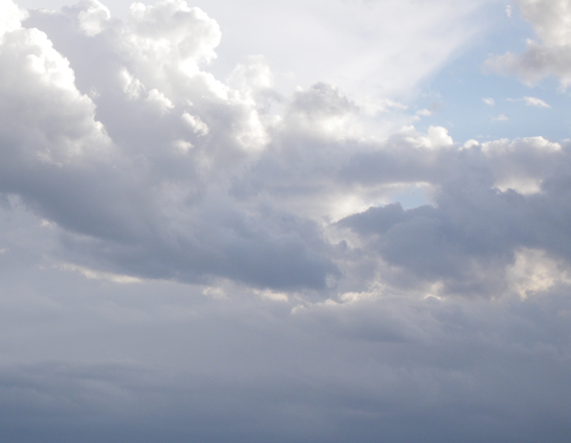

Announcements
ASEN 3728 Aircraft Dynamics
UNIVERSITY OF COLORADO BOULDER

Slide 2
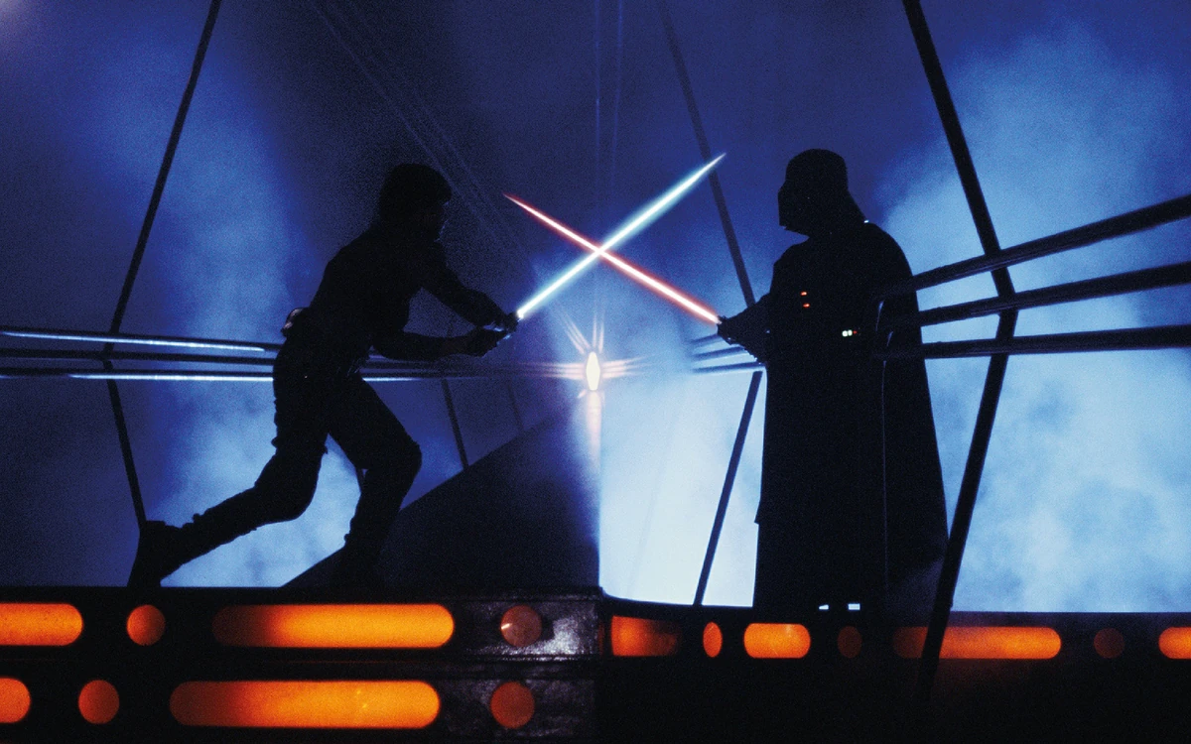
Final Exam
Write everything you want to be graded on the answer sheet
If you need scratch paper, raise your hand
Exam will end at 10 pm
In Problem 2 (d) we meant for you to solve for \dot{u}^E (but, if you already solved for \ddot{x}_E, we will accept that answer)
In Problem 4, parts 1, 2, and 3, you don’t need to choose a numerical value, just choose either k_a, or k_r (and justify it according to the instructions)
In Problem 5, there is a typo: f_r is the same thing as f_b
In Problem 5.1 C_L_0, C_D_0 and T_0 are the Lift Coefficient, Drag Coefficient and Thrust at trim.
Good luck! (May the fourth be with you!)
SCRATCH in LEFT BIN |||||||||||||||||| NO SCRATCH in RIGHT

Slide 3
Final Exam (distraction-reduced environment)
Please leave a space between you and your neighbor
Please do not turn over the exam yet
At 6:15, you may turn over the exam, read the instructions, and sign it.
At 6:16, you may begin.
Write everything you want to be graded on the answer sheet
If you need scratch paper, raise your hand
Exam will end at
8:45 pm for students without time accommodations
10 pm for students with 1.5 time accommodations
Good luck! (May the fourth be with you!)

Slide 4
April 28th Announcements
FCQs open through 4/30
P4 due next Monday (re-download if you want to do the bonus)
Final: Saturday, May 4, 7:30-10pm

Slide 5
April 25th Announcements
If you’re interested in serving as a TF, please fill out the form
FCQs open through 4/30

Slide 6
April 23rd Announcements
Reading Quiz Tonight
FCQs open through 4/30
Feedback: What was most helpful for learning aircraft dynamics? What was least helpful?
Homework P4 due 4/29

Slide 7
April 16th Announcements
Reading Quiz Tonight
Homework W7 due Thursday

Slide 8
April 22nd Announcements
For P4:
Please put everything that needs to be graded in the report pdf! (This will make the TAs’ lives easier)
Please only turn in the documents requested in the assignment

Slide 9
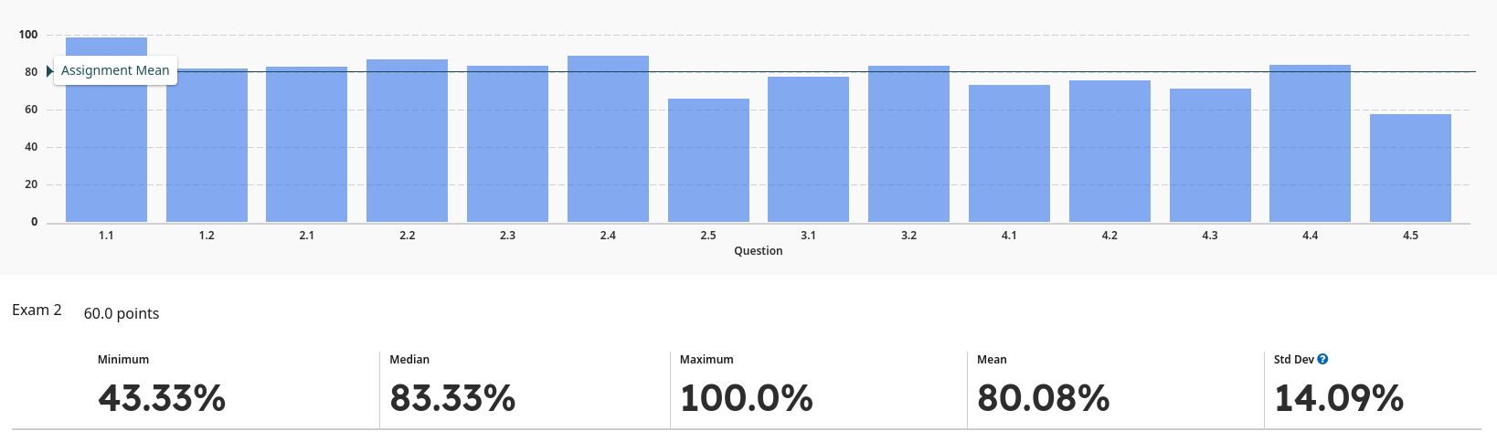
April 8th Announcements
Exam 2 Grade distribution
Homework due dates
Reading Quiz due tonight!

Slide 10
April 2nd, 2024
Reading Quiz, due tonight!
Homework P3, due next Monday
Exam 2 scores released later this week

Slide 11
Exam 2
Good morning!
Please leave an empty seat between you and your classmates
Please do not turn over the exam yet;
At 8:30, you will turn over the exam, read the instructions, and sign it. You will start at 8:31
If you need scratch paper, raise your hand.
Exam will end at 9:46
Good Luck!

Slide 12
March 12
W5 due Thursday
Regrade Requests: this week
Exam 2: March 19 (2 pages of equations front and back)

Slide 13
March 4th
P2 Leaderboard
W4 due Thursday Friday (W5 will be due next Thursday)

Slide 14
Feb 29th
New version of P2 with fractional scoring
+1 bonus point on leaderboard with new version to prevent rounding to victory; max score is now 201
Recommend using git to download course materials

Slide 15
Feb 27th
Reading Quiz due Tonight
Homework P2 due on March 4th.
Colorado Presidential Primary March 5th 🇺🇸
Unaffiliated can vote in either party’s primary
Vote at the UMC [info]

Slide 16
Exam 1
Good morning!
Please leave an empty seat between you and your classmates
Please do not turn over the exam yet;
At 8:30, you will turn over the exam and sign it. You will start at 8:31
Exam will end at 9:46
Good Luck!

Slide 17
Exam Submission
Exam will end at 9:46
If you only wrote on the front sides of numbered pages, put it in the box on YOUR LEFT; if you wrote on any back sides or on scratch paper, put it in the box on YOUR RIGHT
←Front only | Front + Back →
Put your name on any detached sheets (i.e. scratch paper)
Keep crib note sheet

Slide 18
Exam 2 Submission
Exam will end at 9:46
If your answers are in the boxes, put it in the box on YOUR LEFT;
if you wrote answers on scratch paper,
Box anything that should be graded
Put your name on any scratch sheets that should be graded
Staple scratch sheets with answers to the exam
Put it in the box on YOUR RIGHT
←No answers on Scratch | Answers on Scratch →
I do not need the crib/note sheet

Slide 19
Feb 12 Announcements
P1 Leaderboard
Normal Reading Quiz and HW due this week
Please respect your classmates by keeping verbal conversations outside of lecture :)
Exam 1: 2/22

Slide 20
Jan 30 Announcements
Homework P1 due Thursday at midnight
Reading Quiz due Tonight!

Slide 21
Jan 25 Announcements
Change to homework ordering
Paraksh Office Hours

Slide 22
Announcements Jan 23, 2024
Reading Quiz 1 due tonight
HW 1 due Saturday
Make sure you can log in to gradescope (we will use it in class today)
(Some) Office Hours

